Slide 1
Embedded Bluetooth Stack
Dean Camera
Supervisor: Prof. John Devlin
Co-Supervisor: Robert Ross

Slide 2
Project Aims
Develop a functional Bluetooth stack
Designed for embedded use
Focus on low resource usage
Memory Requirements
CPU Requirements
No RTOS requirements
Design and build a functional hardware prototype to demonstrate the stack

Slide 3
Bluetooth Stack

Slide 4
Bluetooth Stack Layers
SDP
Other Services
High level abstracted services
Logical Link Control
and Adaption Protocol
Logical channel management within a device connection
Host Controller Interface
Baseband management including physical connections between devices
Physical Transport
Sends/Receives packets to and from the Bluetooth Controller
USB
Serial

Slide 5
Completed Bluetooth Stack
Supports multiple concurrent connections
Multiple logical channels per connection
L2CAP reliability through a dedicated internal queue
API for integration into user applications

Slide 6
Bluetooth Services
RF Communication (RFCOMM)
Server role only
Provides wireless serial port functionality
Human Interface Device (HID)
Very basic server implementation
Compatible with specific devices only

Slide 7
Completed Services (Cont)
Service Discovery Protocol (SDP)
Server implementation only
Allows for dynamic registration of other services

Slide 8
Demonstration Hardware

Slide 9
Hardware Overview
Small battery operated “ExplorerBot” robot
Allow for user control over Bluetooth connections
Onboard sensors with wireless streaming

Slide 10
Hardware Overview (Cont)
Atmel Inertial One and Pressure One sensor boards
Accelerometer
Gyroscope
Magnetometer
Temperature Sensor
Pressure Sensor
Level Converted I²C Bus

Slide 11
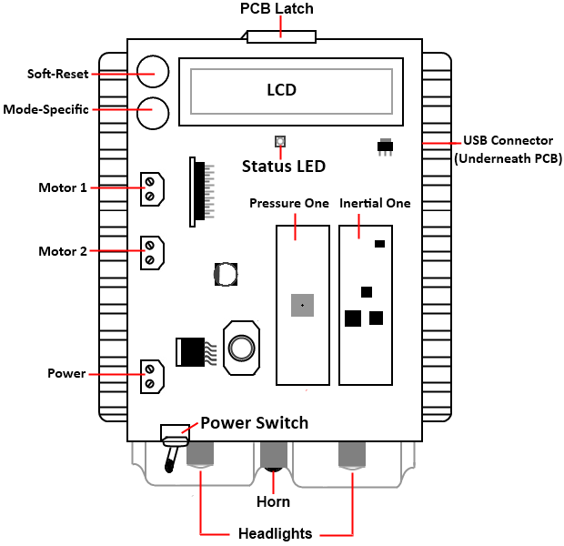
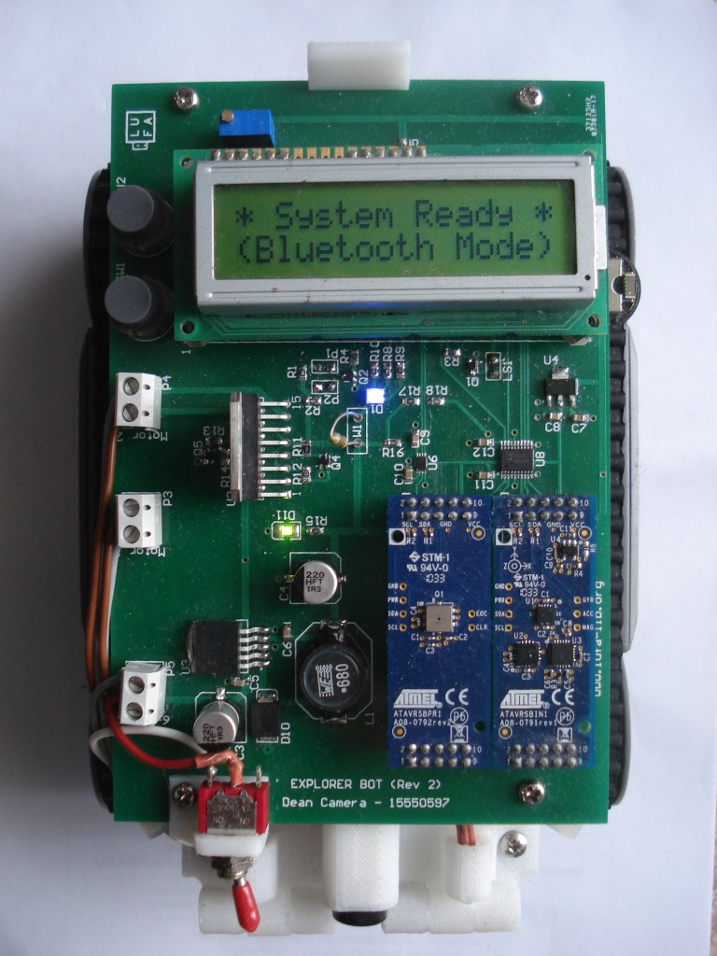
Completed Prototype

Slide 12
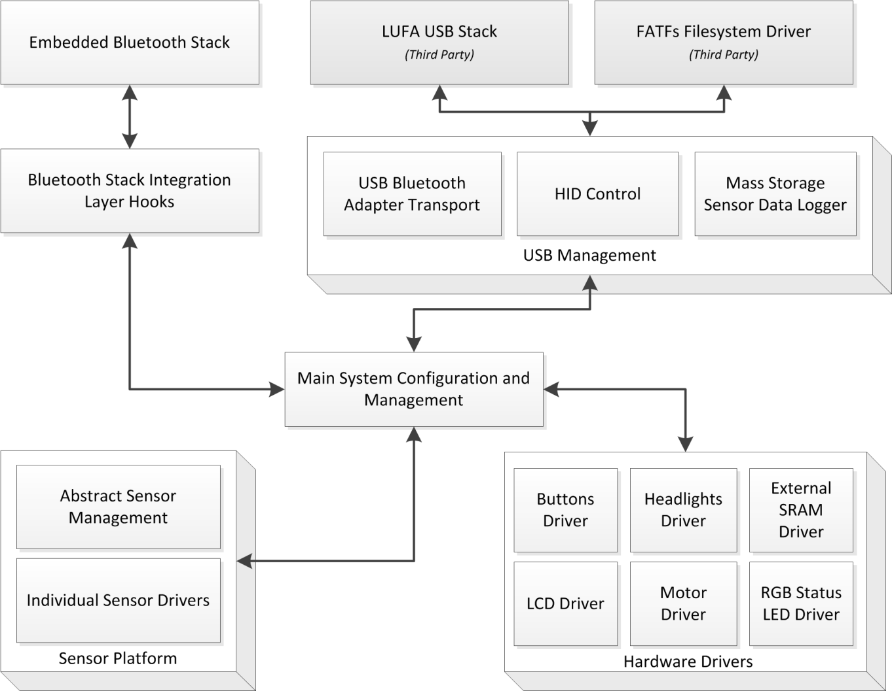
Firmware Block Diagram

Slide 13
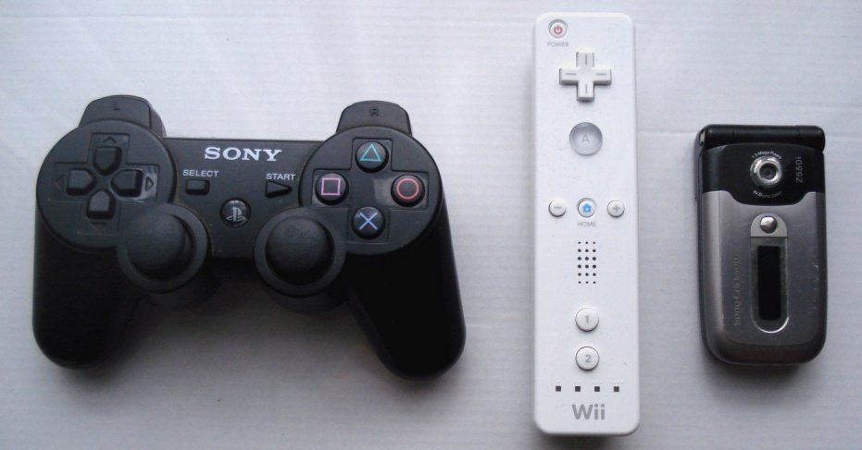
Tested Bluetooth Devices
Motors, horn and headlights controllable
Sony Ericson z550i Mobile Phone
Sony Playstation 3 Controller
Nintendo Wii Controller

Slide 14
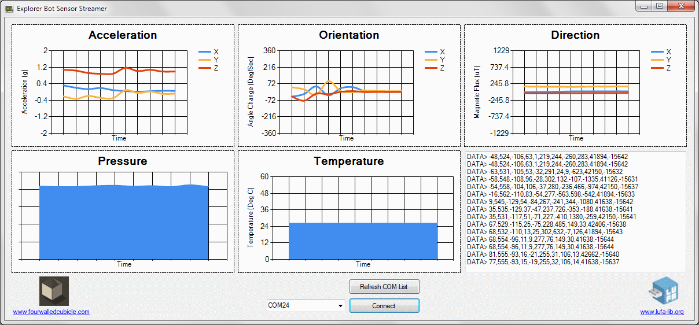
Host Application
Basic sensor streaming host application
Written in C#
Graphs sensor data from the robot in real time

Slide 15
More Information
All project materials (source code, thesis, presentations, photos) uploaded online
Source code released under a MIT license
Full SVN revision history available
www.fourwalledcubicle.com/ExplorerBot.php

Slide 16

Thank You
Notes:
This is the “back slide” in your presentation to show that you have completed your presentation.

